Slide 1
Mpi Collective Communications
Cara Mack
April 27, 2017

Slide 2
What we already know
MPI – Message Passing Interface
Standard library used to send messages between multiple processes
Distributive nature allows MPI to work on almost any parallel environment, unlike OpenMP
Allows for greater control of locality, programmer has to divide memory between processes

Slide 3
Let’s talk
Communicator
Defines a group of processes that have ability to communicate with one another
Each process is assigned a unique rank
Rank allows communication among processes
Communication built upon send and receive operations
Point –to – point communications
Communications which involve one sender and receiver
Collective communications
Method of communication which involves all processes

Slide 4
Types of Collective Communications
Synchronization: processes wait until all members of the group have reached the synchronization point
Data movement: broadcast, scatter, gather, etc.
Collective computation: one member of group collects data from other members and performs an operation on that data (min, max, add, multiply, etc.)

Slide 5
Basic Collective Communications

Slide 6
MPI_Barrier
Forms a barrier and all processes must reach designated point in code before can continue.
Synchronizes program so portions of parallel code are timed accurately
Collective communication implies a synchronization point among processes
MPI_Barrier(MPI_Comm communicator)

Slide 7
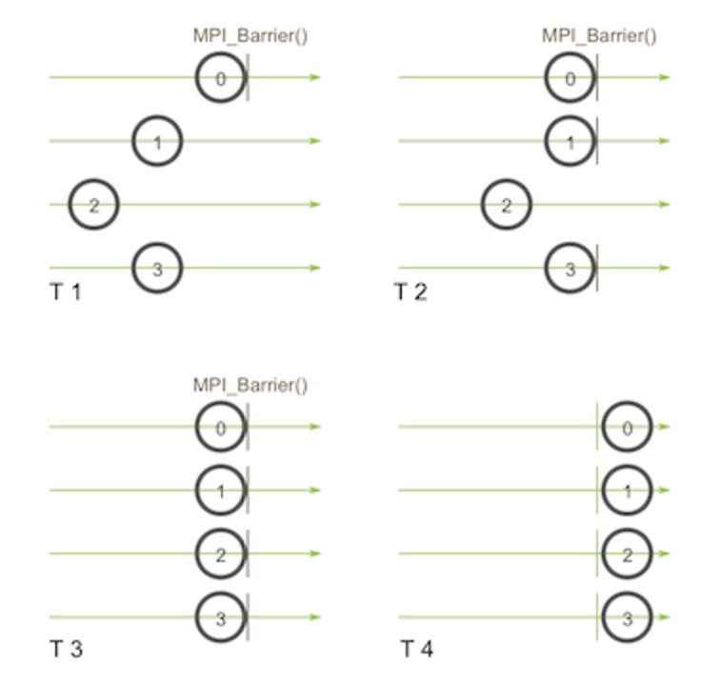

Slide 8
MPI_Bcast
One – to – many communication pattern
One process sends same piece of data to all processes in a communicator
One of the main uses of broadcasting is to send out user input to a parallel program, or send out configuration parameters to all processes.
MPI_Bcast(void* data, int count, MPI_Datatype datatype, int root, MPI_Comm communicator)

Slide 9
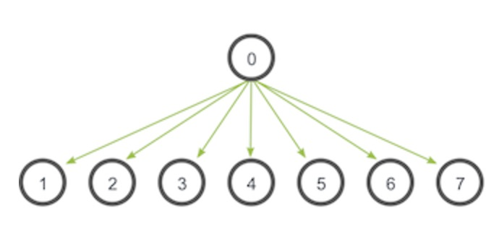

Slide 10
MPI_Scatter
One – to – many communicator pattern
Involves a designated root process sending data to all processes in a communicator
Sends chunks of an array to different processes and distributes the elements in the order of process rank.
MPI_Scatter(void* send_data, int send_count, MPI_Datatype send_datatype, void* recv_data, int recv_count, MPI_Datatype recv_datatype, int root, MPI_Comm communicator)

Slide 11
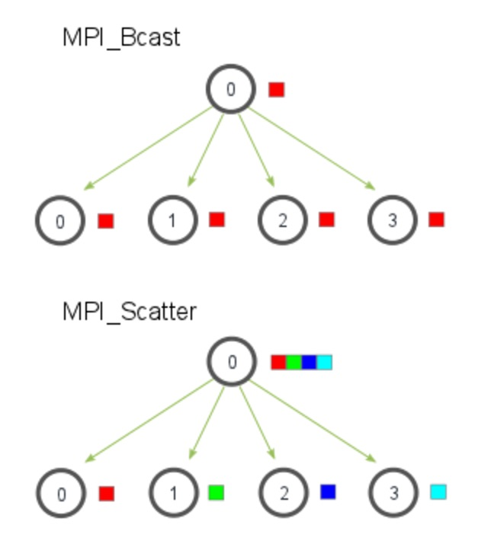

Slide 12
MPI_Gather
Many – to – one communicator pattern
The inverse of MPI_Scatter, MPI_Gather takes elements from many processes and gathers them to one single process
The elements are ordered by the rank of the process from which they were received
MPI_Gather(void* send_data, int send_count, MPI_Datatype send_datatype, void* recv_data, int recv_count, MPI_Datatype recv_datatype, int root, MPI_Comm communicator)

Slide 13
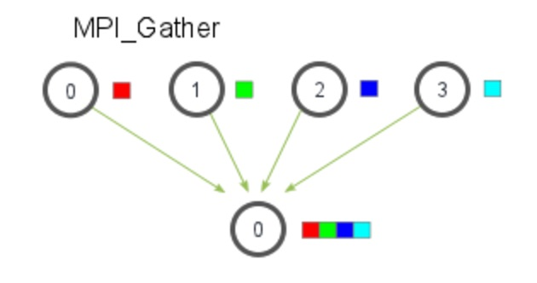

Slide 14
MPI_Allgather
Many – to – many communicator pattern
Gather all of the elements to all the processes
Sorta like an MPI_Gather followed by an MPI_Bcast
The elements from each process are gathered in order of their rank to all processes
MPI_Allgather(void* send_data, int send_count, MPI_Datatype send_datatype, void* recv_data, int recv_count, MPI_Datatype recv_datatype, MPI_Comm communicator)

Slide 15
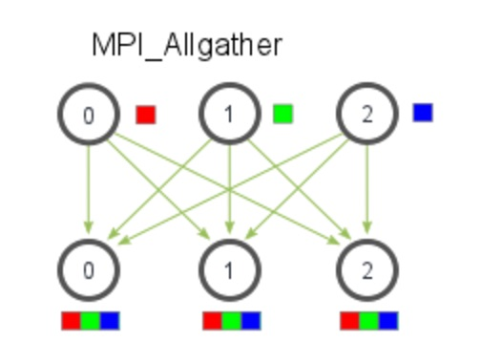

Slide 16
Advanced Collective Communications

Slide 17
MPI_Reduce
Similar to MPI_Gather, MPI_Reduce takes an array of input elements on each process and returns an array of output elements to the root process.
MPI_Reduce(void* send_data, void* recv_data, int count, MPI_Datatype datatype, MPI_Op op, int root, MPI_Comm communicator)

Slide 18
op parameter: Operations
MPI_MAX
MPI_MIN
MPI_SUM
MPI_PROD
MPI_LAND
MPI_LOR
MPI_BAND
MPI_BOR
MPI_MAXLOC
MPI_MINLOC
Returns max element
Returns min element
Sums elements
Multiplies elements
Logical AND operator
Logical OR operator
Bitwise AND across the bits of elements
Bitwise OR across the bits of elements
Returns max value and rank of process
Returns min value and rank of process

Slide 19
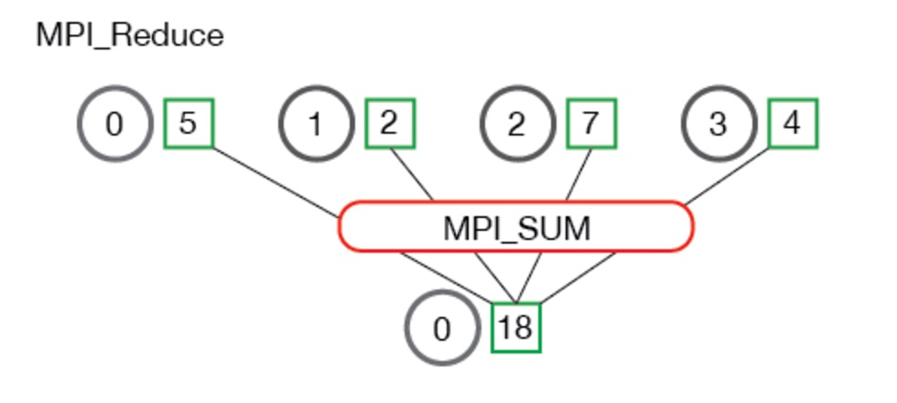

Slide 20
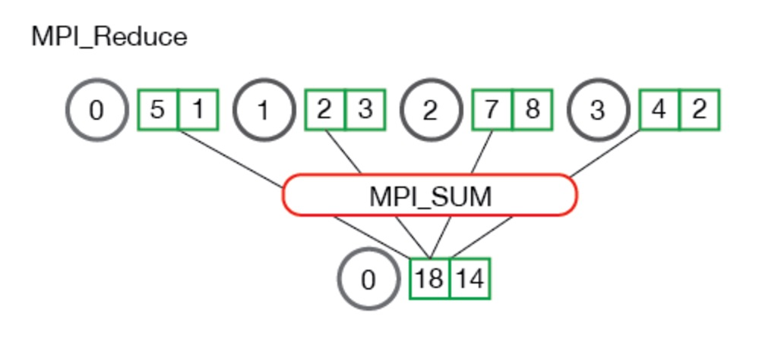
more than one element per process

Slide 21
MPI_Allreduce
Reduce the values and distribute the results to all processes
MPI_Allreduce is basically doing MPI_Reduce followed by an MPI_Bcast.
MPI_Allreduce(void* send_data, void* recv_data, int count, MPI_Datatype datatype, MPI_Op op, MPI_Comm communicator)

Slide 22
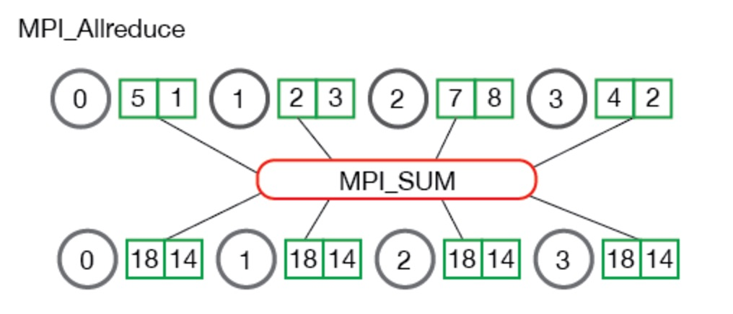

Slide 23
Sources
Pacheco, Peter S. Parallel Programming with MPI. San Frascisco, CA: Morgan Kaufmann
https://computing.llnl.gov/tutorials/mpi/
http://www.mcs.anl.gov/research/projects/mpi/
Graphs: http://mpitutorial.com/tutorials/
Additional Information : MPI Forum (http://mpi-forum.org/)

